Slide 1

Super Mario App
Creating an Elastic Container Service with EC2
Tiana Coats
Notes:
Introduce the project and drop the link to the static site http://s3.tianacoatsweb.s3-website-us-east-1.amazonaws.com
On the website you can access my design doc and my implementation doc. I also have a powerpoint to give an overview of how I completed the project, but the implementation doc has the more detailed steps of the process.
For the presentation I will be going over the customer scenario, the architecture needed to meet their request, and the benchmark test results.
I will also be jumping from the powerpoint to the console for to demo setting up some of the services.
Have open:
https://quip-amazon.com/UTPwACnIZ4v4/Super-Mario-App-ECS-with-EC2-Design-Doc
https://quip-amazon.com/MyBUAK5IiI9r/Capstone-Implementation
Console
Website

Slide 2
Overview
Scenario:
The customer has developed a Super Mario Docker application but struggles with deploying it in a scalable, highly available manner. Their current infrastructure lags and is unstable when over 5,000 devices access the application. They need a solution that can automatically adjust to varying traffic loads, distribute requests efficiently, and provide protection against common web threats. The current setup lacks elasticity and resilience, leading to performance issues during traffic spikes and potential downtime.

Slide 3
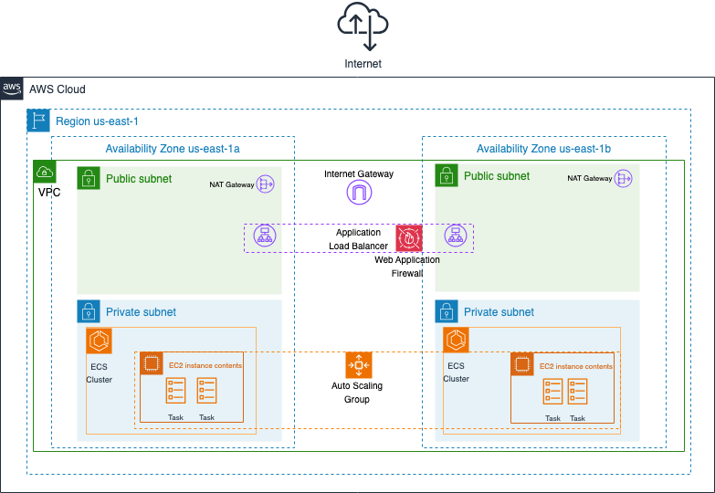
Architecture
Requirements
Highly available- 99.99%
Auto-scaling triggers- 70% CPU utilization
Deploy in 2 AZs for HA
Web access firewall

Slide 4
Architecture
Key Services
AWS ECS
EC2
Application load balancer
Launch template
Auto scaling
Cloudwatch
Security
Web Access Firewall
Security groups

Slide 5
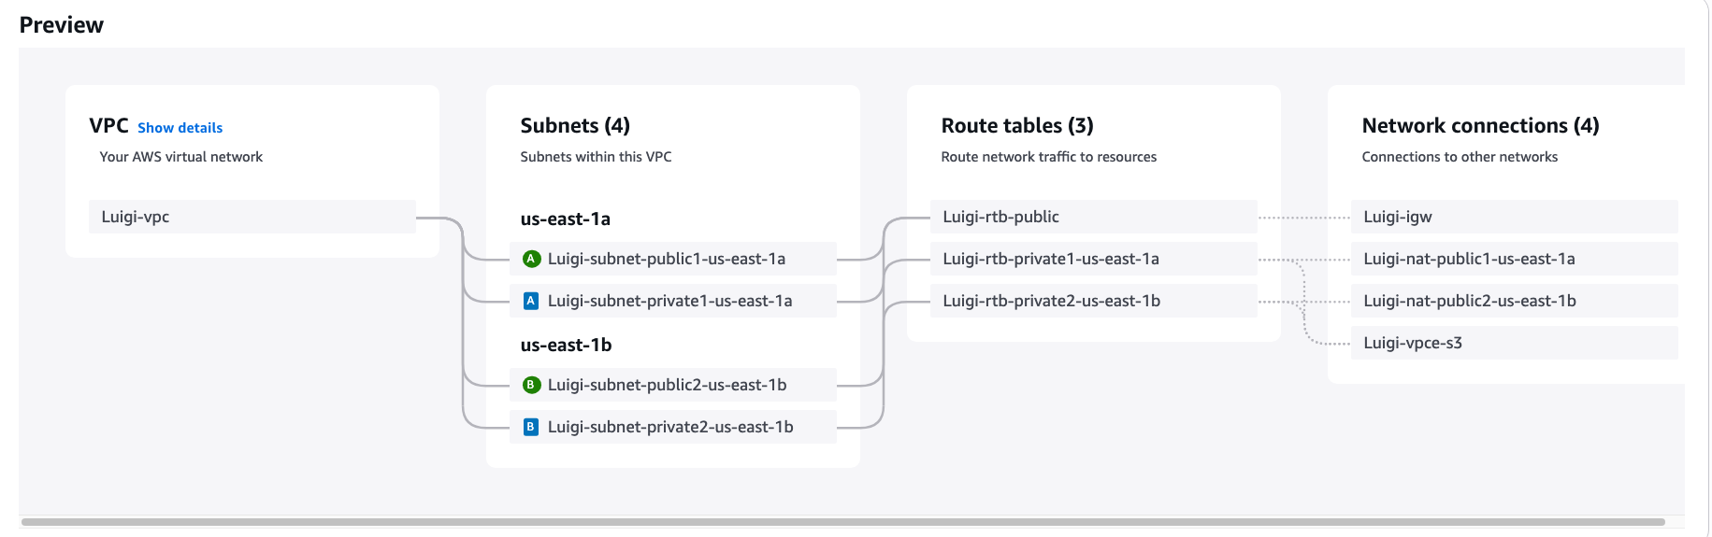
1. VPC Configuration
2 public and 2 private subnets across 2 AZs
NAT gateway in both public subnets
Route tables and NACLs were created automatically when we use ‘VPC and more’
Elastic IPs are associated with this VPC
Notes:
Go to console and show
VPC >
NACLs
NAT Gateways
Route Table
Elastic IPs

Slide 6
Security Configuration
Security Groups
Application load balancer- Accepting inbound HTTP traffic from port 80
ECS- Accepting inbound TCP traffic from port 8080 (ALB)
IAM Roles
ECS Task Execution Role- Allows ECS tasks to call AWS services
EC2 Instance Role- Allows EC2 instances to serve as ECS container instances
ECS Task Role
I created a custom policy allowing Elastic Container Registry and Cloudwatch logs

Slide 7
ECS Cluster Configuration Demo
Create ECS cluster
EC2 instances
The network (VPC and subnets) that tasks will run on
Monitoring with Cloudwatch Insights
Create ASG
Create task definitions
Launch types
Task roles
Container details
Notes:
Demo how to create the cluster in console
Now that we have the security components setup we can create the ECS cluster and Task definitions

Slide 8
Create Launch Template
Check ‘provide guidance to help me set up a template that I can use with EC2 Auto Scaling’
For AMI chose Amazon ECS-Optimized > amzn2-ami-ecs-hvm-2.0.20250716-x86_64-ebs
This AMI is optimized for ECS
Instance type > t3.small
I originally choose t2.micro but got an insufficient capacity error
Choose key pair
For firewall security group choose Luigi-ECS-SG
Leave storage volumes as default
Expand Advanced Details
For IAM Instance Profile choose Luigi-EC2-Instance-Role
Enable Detailed CloudWatch Monitoring
To ensure that new instances launched will automatically join the cluster enter this user data:
#!/bin/bash echo "ECS_CLUSTER=luigi-cluster" >> /etc/ecs/ecs.config
Notes:
Here are the details that I input when creating the launch template. We will connect this launch template with the ASG in the next step.

Slide 9
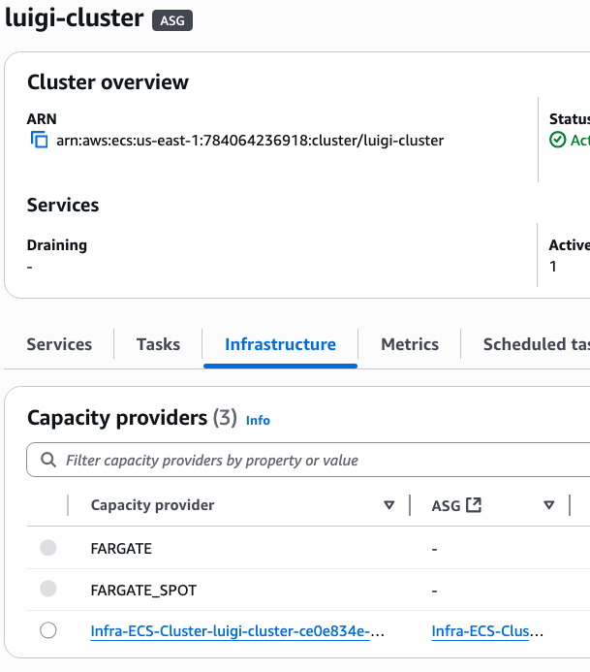
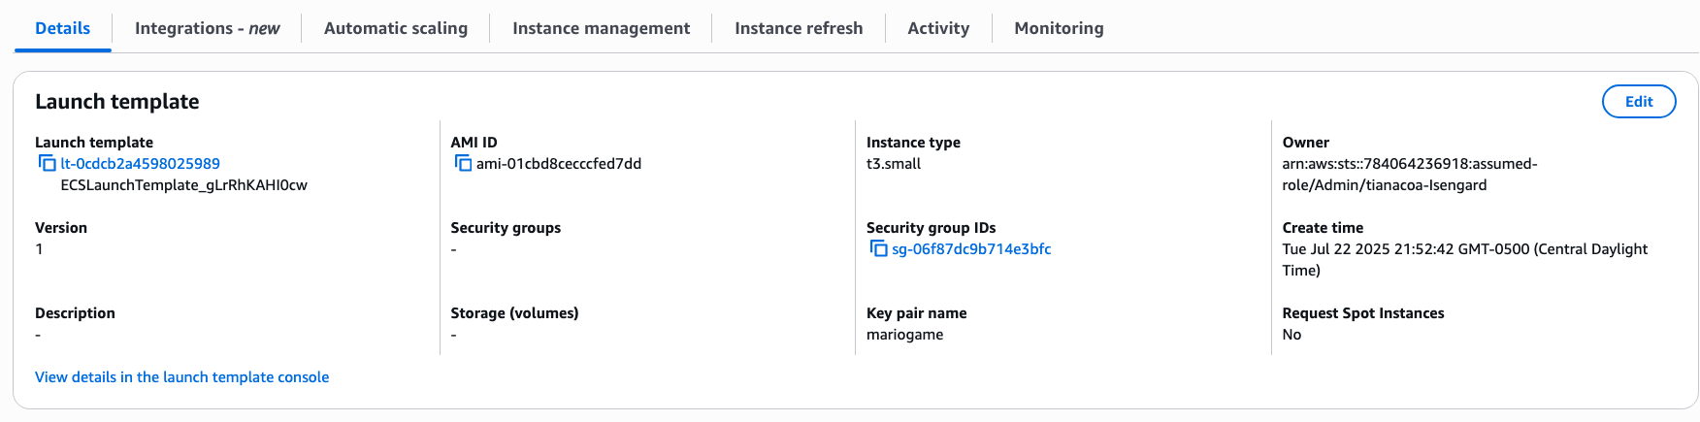
Configure Auto Scaling Group
Cluster
Infrastructure
Click on ASG
ASG > Details > Edit > Add in launch template
Notes:
Here are the details that I input when creating the launch template. We will connect this launch template with the ASG in the next step.

Slide 10
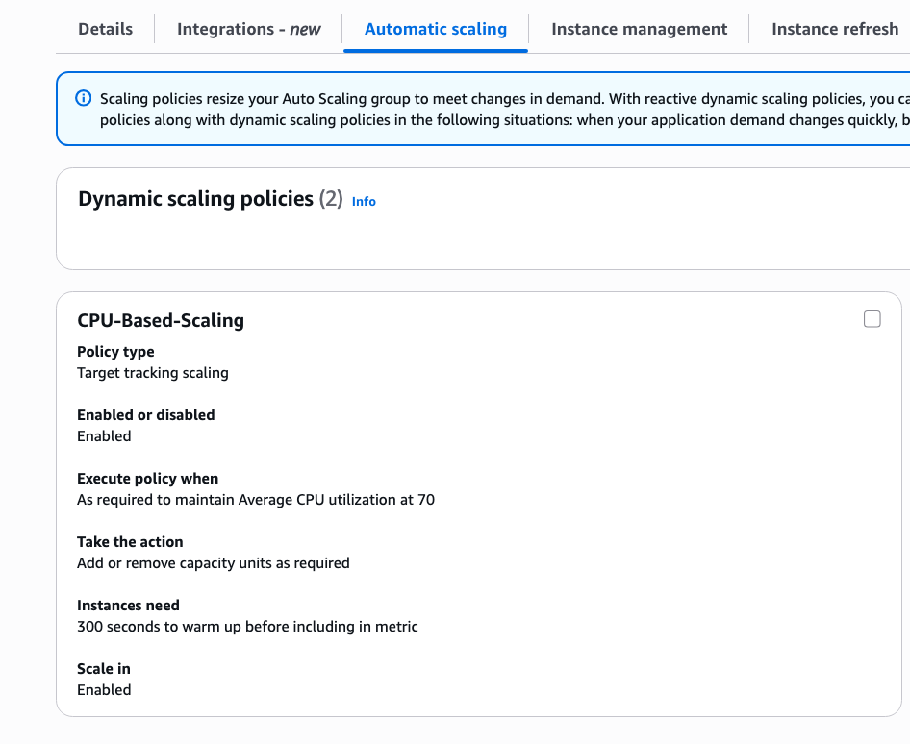
Configure Auto Scaling Group
ASG > Automatic Scaling > Create dynamic scaling policy
Target tracking policy
Average CPU utilization
Target value 70
Notes:
Here are the details that I input when creating the launch template. We will connect this launch template with the ASG in the next step.

Slide 11
Create an ALB and Target Group
Application Load Balancer
Internet facing ALB
Placed in the public subnets
Assign the ALB security group that was created earlier
Listeners and routing
HTTP protocol on port 80
Create Target Group
IP addresses
HTTP protocol on port 8080 (Receiving traffic from the ALB)
Notes:
When creating the target group I used IP addresses because Facilitates routing to multiple IP addresses and network interfaces on the same instance
Since we are using awsvpc networking for the cluster each task will have it’s own IP

Slide 12
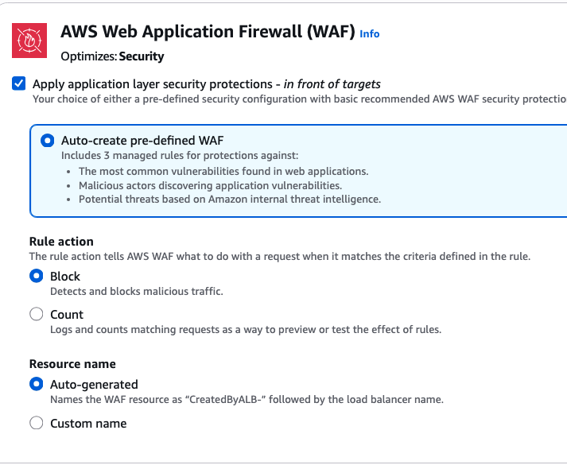
Create an ALB and Target Group
When creating the load balancer I enabled WAF. This will work with the ALB to filter out any malicious traffic before it makes it to the instances.

Slide 13
Create the ECS Service Demo
Creating the service will:
Managing the number of tasks running
When configured with the ALB it will distribute traffic to the tasks
It will auto adjust the number of tasks based on the parameters I input
Notes:
The last thing we need to create for everything to come together is the cluster service. The service will act as a manager for the tasks. I will demo how to create this on the console.
Now that the whole architecture is done the App is up and running as I demonstrated earlier
Also, show that the two EC2 instances are running
Cluster > Infrastructure

Slide 14
CloudWatch Monitoring
I created a CloudWatch Dashboard to monitor traffic and resources for the cluster.
After I created the dashboard, I ran a benchmark test to send a large amount of traffic to the ALB.
Notes:
I’m going to switch over to my implementation doc to present the results of the benchmark test that I ran.

Slide 15
Questions?

